Slide 1
MDS272A - WEB ANALYTICS - Credits:5
Unit 1: INTRODUCTION TO WEB ANALYTICS
Introduction to Web Analytics: Web Analytics Approach – A Model of Analysis – Context matters – Data Contradiction – Working of Web Analytics: Log file analysis – Page tagging – Metrics and Dimensions – Interacting with data in Google Analytics
Unit 2: LEARNING ABOUT USERS THROUGH WEB ANALYTICS
Goals: Introduction – Goals and Conversions – Conversion Rate – Goal reports in Google Analytics – Performance Indicators – Analyzing Web Users: Learning about users – Traffic Analysis – Analyzing user content – Click-Path analysis – Segmentation

Slide 2
MDS272A - WEB ANALYTICS
Unit 3: GOOGLE ANALYTICS
Different analytical tools - Key features and capabilities of Google analytics- How Google analytics works - Implementing Google analytics - Getting up and running with Google analytics -Navigating Google analytics – Using Google analytics reports -Google metrics - Using visitor data to drive website improvement- Focusing on key performance indicators- Integrating Google analytics with third-Party applications
Unit 4: OVERVIEW OF QUALITATIVE ANALYSIS
Lab Usability Testing- Heuristic Evaluations- Site Visits- Surveys (Questionnaires) - Testing and Experimentation: A/B Testing and Multivariate Testing-Competitive Intelligence - Analysis Search Analytics: Performing Internal Site Search Analytics, Search Engine Optimization (SEO) and Pay per Click (PPC)-Website Optimization against KPIs- Content optimization- Funnel/Goal optimization - Text Analytics: Natural Language Processing (NLP)- Supervised Machine Learning (ML) Algorithms-API and Web data scarping using R and Python

Slide 3
MDS372B - WEB ANALYTICS
Unit 5: VISUAL ANALYTICS
VISUAL ANALYTICS: Drill down and hierarchies-Sorting-Grouping- Additional Ways to Group- Creating Sets- Analysis with Cubes and MDX- Filtering for Top and Top N- Using the Filter Shelf- The Formatting Pane- Trend Lines- Forecasting- Formatting- Parameters - SOCIAL NETWORK ANALYSIS: Types of social network-Graph Visualization-Network Relationships-Network structures: equivalence-Network Evolution-Diffusion in networks- Descriptive Modeling-Predictive Modeling-Customer Profiling-Network targeting
Text Books And Reference Books:
1. Beasley M, (2013), Practical web analytics for user experience: How analytics can help you understand your users. Newnes, 1st edition, Morgan Kaufmann.
2. Sponder M, (2013), Social media analytics: Effective tools for building, interpreting, and using metrics, 1st edition, McGraw Hill Professional.
3. Clifton B, (2012), Advanced Web Metrics with Google Analytics, 3rd edition, John Wiley & Sons..

Slide 4
Web Analytics
process of analyzing the behavior of visitors to a website
involves tracking, reviewing and reporting data to measure webactivity
-website and its components ( webpages, images and videos)
Web Analytics can help in the following ways:
Determine the likelihood that a given customer will repurchase a product after purchasing it in the past.
Personalize the site to customers who visit it repeatedly.
Monitor the amount of money individual customers or specific groups of customers spend.
Observe the geographic regions from which the most and the least customers visit the site and purchase specific products.

Slide 5
Importance of Web Analytics
Assess web content problems so that they can be rectified
Have a clear perspective of website trends
Monitor web traffic and user flow
Demonstrate goals acquisition
Figure out potential keywords
Identify segments for improvement
Find out referring sources

Slide 6
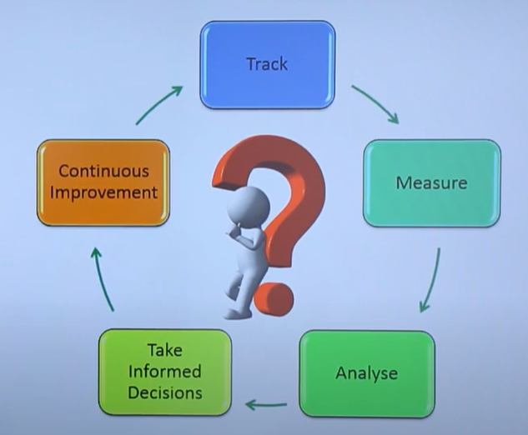
Process of Web Analytics

Slide 7
Process of Web Analytics
Set the business goals.
To track the goal achievement, set the Key Performance Indicators (KPI).
Collect correct and suitable data.
To extract insights, Analyze data.
Based on assumptions learned from the data analysis, Test alternatives.
Based on either data analysis or website testing, Implement insights.

Slide 8
Web Analytics Examples
Pageviews
Unique Pageviews
Sessions
New Visitors
Returning Visitors
Traffic Sources
Bounce Rate

Slide 9
Web Analytics Best Practices
Pick metrics that align with your business objectives.
Use data to drive decision-making
Change the product page link to most visited page
Don’t limit your focus to traffic.
Always pair data with insights.
Share and ask for feedback from stakeholders.

Slide 10
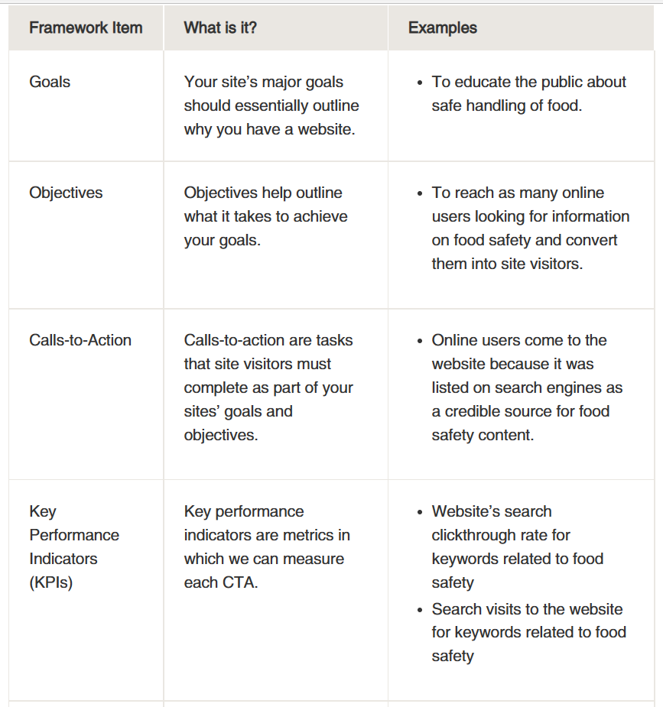
Example for building a measurement framework for an informational website:

Slide 11
Example for building a measurement framework for an informational website:

Slide 12
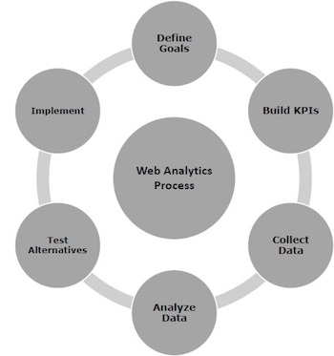

Slide 13
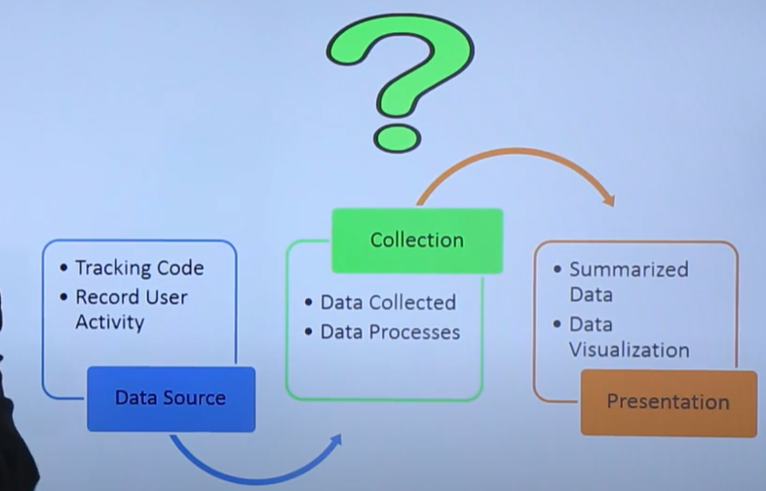


Source Insight

Slide 14
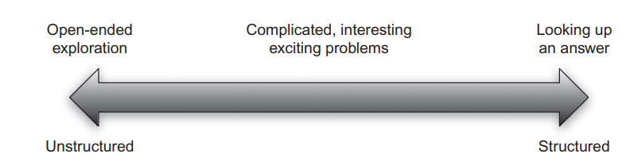
Source: FIGURE 2.3 Analysis can range from completely open-ended to completely structured. Most UX questions fall between these two poles.

Slide 15
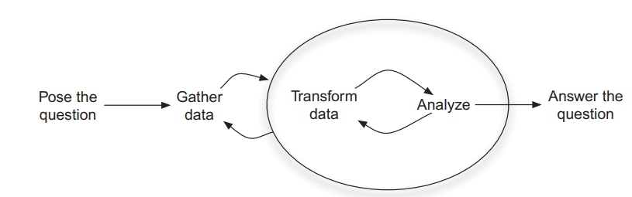
Semi-structured analysis involves iterations of gathering, transforming, and analyzing data

Slide 16
Web Analytics
Google Analytics
Optimizely
KISSmetrics
Crazy Egg
Key Metrics
Data Sources
Segmentation
Dashboards
Conversion
Emerging Analytics

Slide 17
Google Analytics
Google Analytics is a freemium analytic tool that provides a detailed statistics of the web traffic.
It is used by more than 60% of website owners.
Google analytics helps you to track and measure visitors, traffic sources, goals, conversion, and other metrics.
It basically generates reports on −
Audience Analysis
Acquisition Analysis
Behavior Analysis
Conversion Analysis

Slide 18
Audience Analysis
audience analysis gives an overview of the audience who visit your site along with their session history, page-views, bounce rate, etc.
The age and gender of your audience under Demographics.
The affinity reach and market segmentation under Interests.
Language and location under Geo.
New and returning visitors, their frequency, and engagement under Behavior.
Browsers, Operating systems, and network of your audience in Technology.
Mobile device info under Mobile.
Custom variable report under Custom. This report shows the activity by custom modules that you created to capture the selections.
Benchmarking channels, locations, and devices under Benchmarking. Benchmarking allows you to compare your metrics with other related industries. So, you can plot what you need to incur in order to overtake the market.
Flow of user activity under Users flow to see the path they took on your website.

Slide 19
Acquisition Analysis
Acquisition means ‘to acquire.’
Acquisition analysis is carried out to find out the sources from where your web traffic originates.
Using acquisition analysis, can −
Capture traffic from all channels, particular source/medium, and from referrals.
Trace traffic from AdWords (paid search).
See traffic from search engines. Here, you can see Queries, triggered landing pages, and geographical summary.
Track social media traffic. It helps you to identify networks where your users are engaged. It helps you measure the impact of social media on your website.
See which plug-ins gave you traffic.
Have a look at all the campaigns you built throughout your website with detailed statistics of paid/organic keywords and the cost incurred on it.

Slide 20
Behavior Analysis
Behavior analysis monitors users’ activities on a website.
Site Content − It shows how many pages were viewed.
can see the detailed interaction of data across all pages or in segments like content drill-down, landing pages, and exit pages.
Content drill-down is breaking up of data into sub-folders.
Landing page is the page where the user lands,
exit page is where the user exits your site. You can measure the behavioral flow in terms of content.
Site Speed − can capture page load time, execution speed, and performance data.
can measure page timings, user timings, and get speed suggestion.
It helps to know where you are lagging.

Slide 21
Behavior Analysis
Site Search − It gives a full picture of how the users search across the site, what they normally look for, and how they arrive at a particular landing page.
can analyze what they search for before landing on your website.
Events − Events are visitors’ actions with content, which can be traced independently. Example − downloads, sign up, log-in, etc.

Slide 22
Conversion Analysis
Conversion is a goal completion or a transaction by a user on your website. For example, download, checkout, buy, etc.
Goals
Ecommerce
Multi-channel funnels
Attribution

